Slide 1

Transparent Donation Tracking System
NEKITRACE
A Donation-tracking platform. Donors browse real charity projects and campaigns, see who they're helping and why, and track the projects.
Presenter: Nimra Sultan
Department: Information Technology
Organization: Fauji Foundation

Slide 2

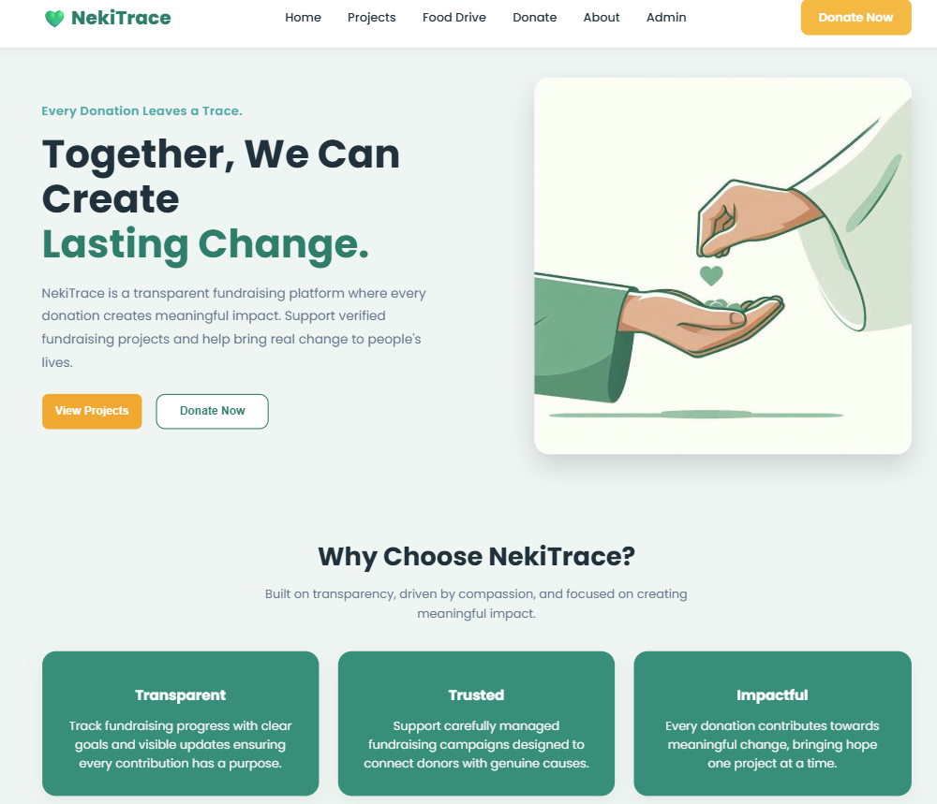

What is NekiTrace?
NekiTrace is a web-based fundraising platform developed to make donations transparent, auditable, and donor-friendly. It enables donors to follow each rupee and provides NGOs with tools to manage projects and publish verified progress.
Web based platform
Accessible anywhere donors can view campaigns, goals, and progress in real time.
Transparency first
Donation proofs, receipts, and project updates are stored and linked to each contribution.
Admin management
Project creation, beneficiary records and managing beneficiaries and charity projects through a secure admin panel.

Slide 3
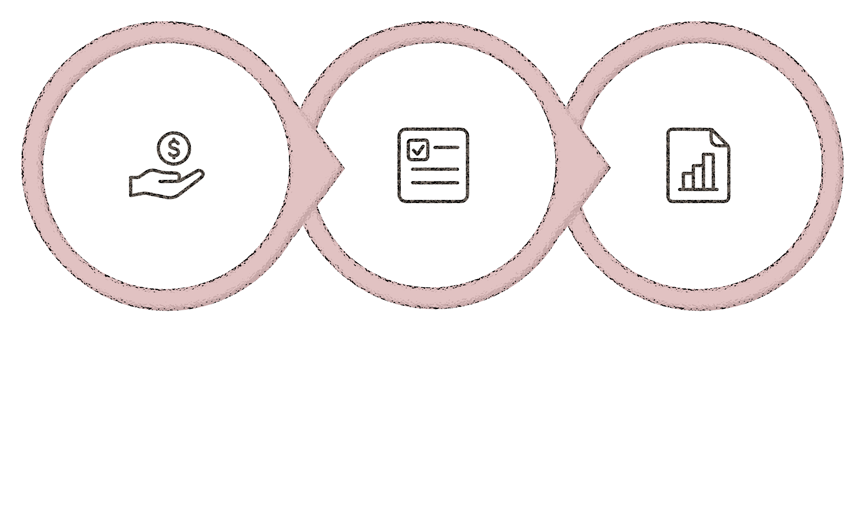
Problem Statement
Many NGOs struggle to keep donors informed:
Updates posted to Instagram, WhatsApp, or Facebook disappear or are hard to audit. Donors need lasting records and clear proof that funds reached intended beneficiaries.
Collect Donations
Verify & Record
Publish Impact
NekiTrace addresses this by centralizing donation records, attaching transaction evidence, and publishing verified project status in one persistent place.

Slide 4
Tools & Software Stack
React.js
1
Responsive, component-driven UI designed for clarity and trust.
Spring Boot
2
Secure, scalable Java backend powering REST APIs, business logic, and transactional workflows.
SQL Server
3
Relational storage with strong integrity guarantees for donations, users, beneficiaries, and projects.
These technologies combine to create a reliable, maintainable system that supports growth while protecting donor and beneficiary data.

Slide 5
Key Features: What Donors & NGOs See
Project Marketplace
Browse curated fundraising campaigns with goals, descriptions, and beneficiary stories.
Donate with Proof
Upload transaction screenshots to link contributions to payments for on-record verification.
Track Progress
Real-time progress bars and milestone updates show exactly what amount I collected.
Admin Dashboard
Manage campaigns, beneficiaries, and reconcile donations from a single secure console.

Slide 6
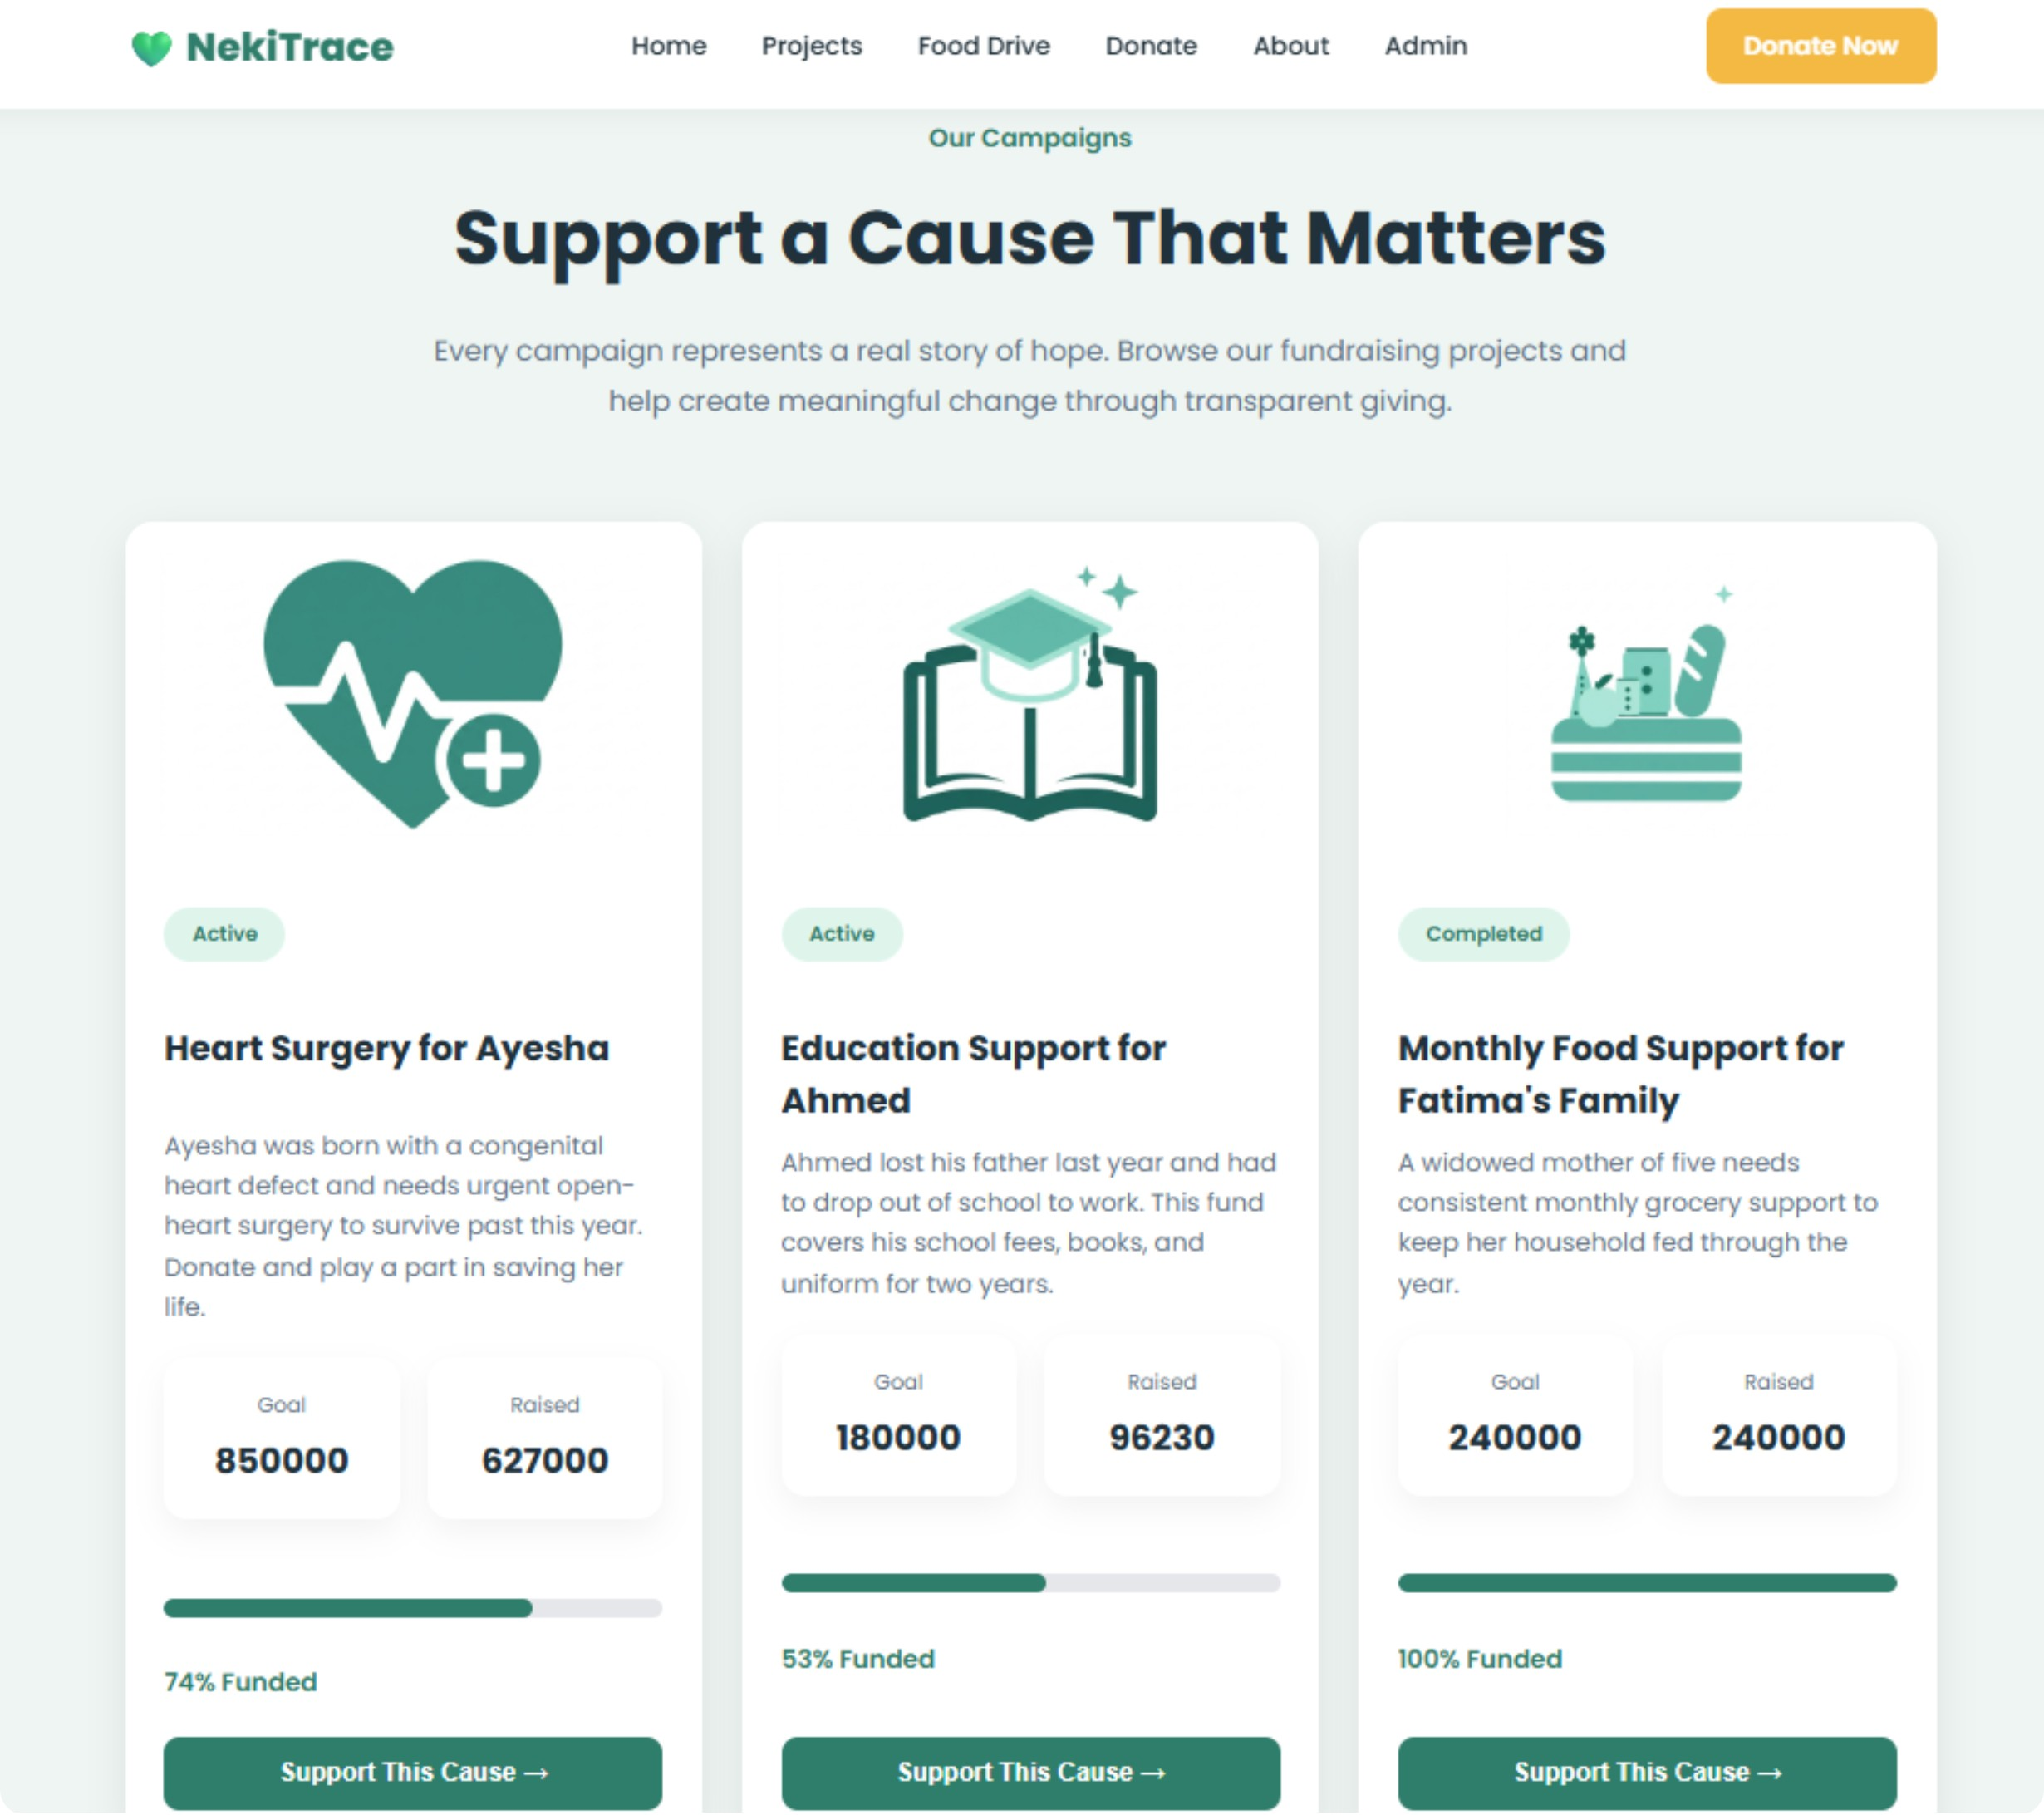
Frontend Development: Donor’s Experience
Design goals
Clear campaign cards that highlight goals, raised amount, and remaining need.
Simple donation form with preset amounts, custom entry, and optional anonymity.
Upload field for transaction proof to maintain an auditable trail.
Projects Page:
The UI emphasizes trust signals, progress bars, beneficiary stories, and visible receipts to increase donor confidence and conversion.
All Charity projects on one page

Slide 7
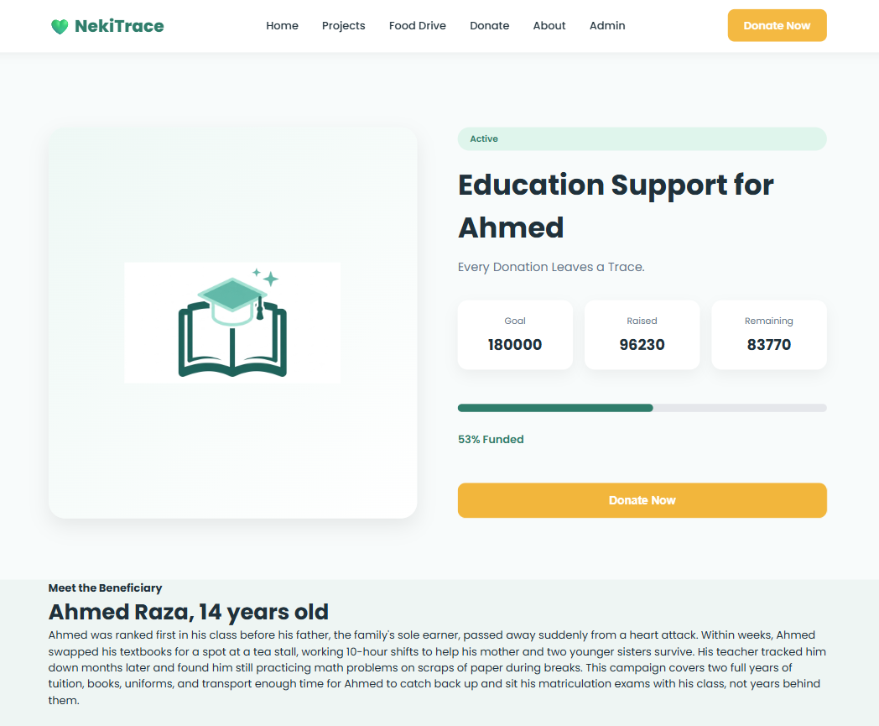
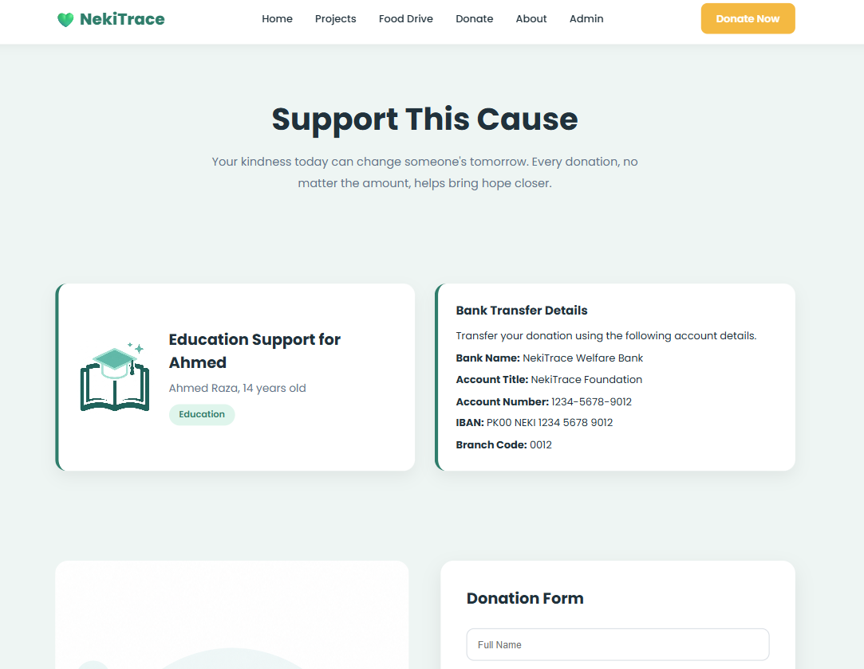
Details of a charity project if
someone wants to support that project
Donation page for every specific
charity project

Slide 8
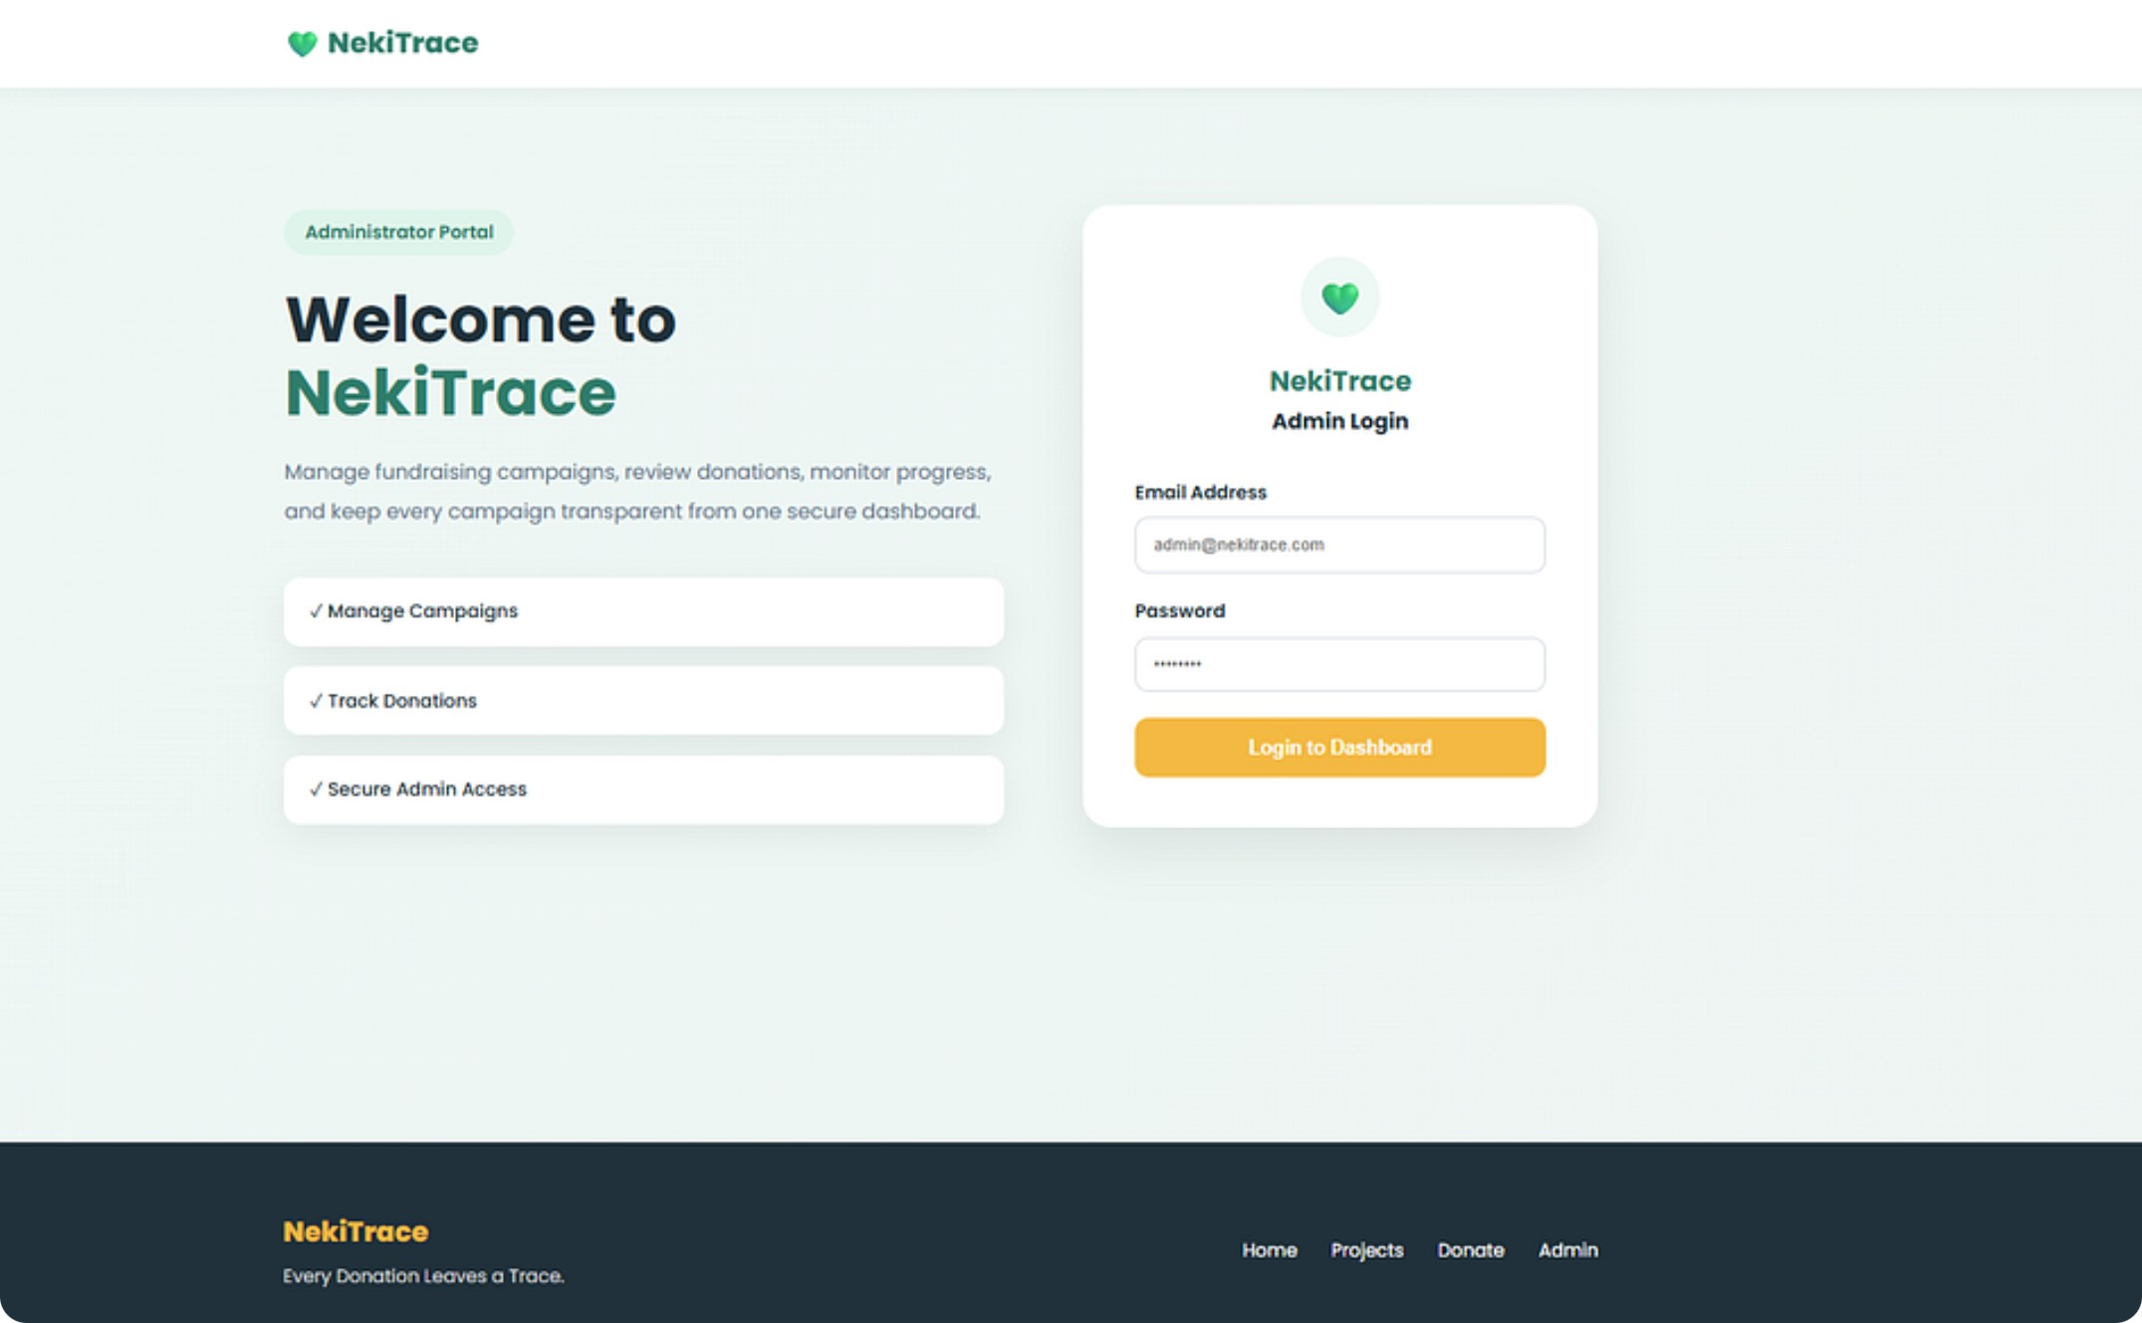
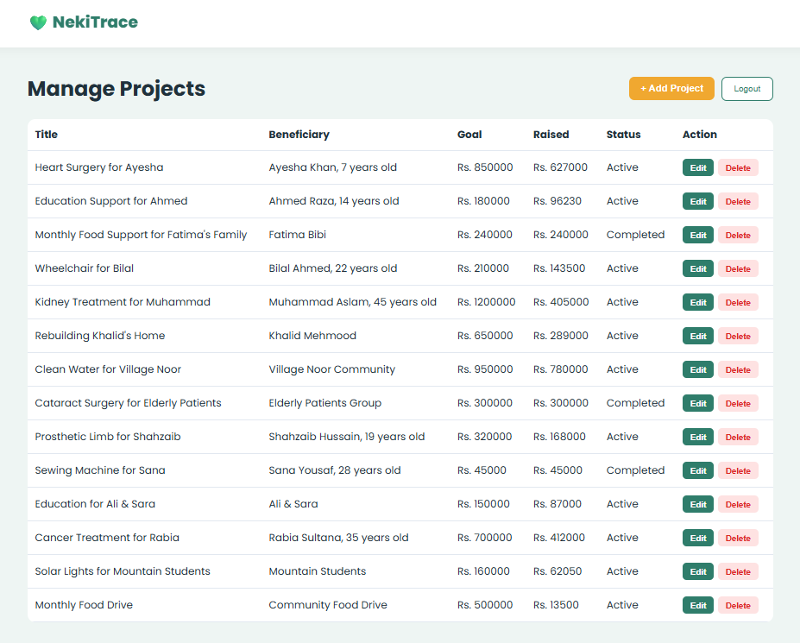
Admin Interface & Dashboard
Admins use a secure portal to create campaigns, upload beneficiary details, and edit or delete them after completion. Each project page includes: Goal, raised, and remaining amounts with progress visualization.

Slide 9
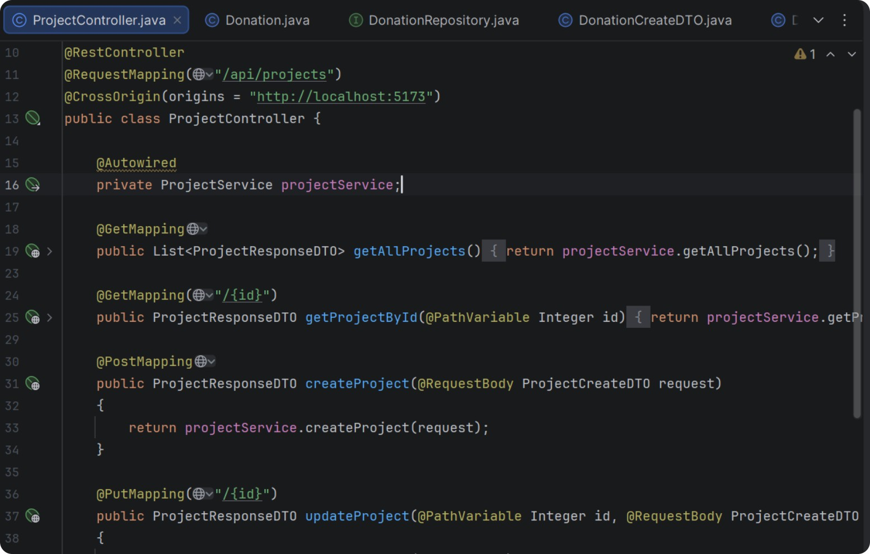
Backend: Reliability & Security
1
REST APIs
Endpoints for project management, donations, user profiles,
and admin actions,
2
Auth & Access Control
Role-based authentication for admins and secure donor sessions.
3
Data Integrity
SQL Server enforces relational integrity for transactions.

Slide 10

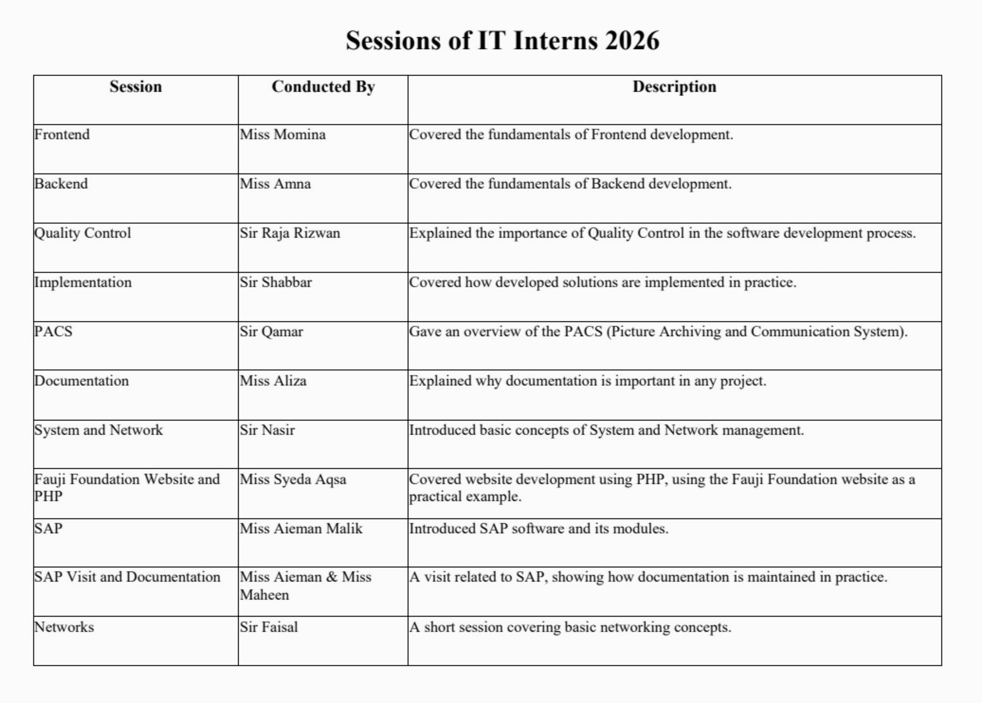
Sessions of IT Interns 2026
Training highlights:
Focused sessions on Frontend, Backend, Quality Control, Implementation, PACS, Documentation, System & Network, and practical website development using the Fauji Foundation site as a case study..

Slide 11
Thank You

